Slide 1

Memory Skills Group
Week 6 : Keeping well, course reviews and goodbyes
Rebecca Niebieszczanski (Trainee Clinical Psychologist)
Kirsty Ellis (Assistant Psychologist)
Lesley Stewart (Consultant Clinical Neuropsychologist)
Revised 2021
Grace Sunerton (Assistant Psychologist)
Alice Roblin (Senior Clinical Psychologist)

Slide 2

Welcome!
Notes:
Welcome participants to the group
Explain that the group is for individuals who report difficulties with their memory
Important that we have realistic expectations that the group is not about ‘getting rid’ of our memory difficulties
The group will offer skills and information that will help us to manage these memory difficulties
2 hours with break

Slide 3




Housekeeping:
Notes:
Breaks – including toilet breaks
No recording of the session
Mobile phones on silent/vibrate to minimise distractions

Slide 4
Overview of the course:
Session 1 Introductions and an overview of cognitive abilities
Session 2 Overview of memory
Session 3 External memory enhancement strategies
Session 4 Internal memory enhancement strategies
Session 5 Mood and cognitive functioning
Session 6 Keeping well, course reviews and goodbyes
Notes:
6x 2 hour sessions
The emphasis of this group is active participation and it is equally important to contribute as much as you feel you can.
It is also important that you attend all the sessions, however, if for some reason you can’t attend the group - let us know
Taught materials
Discussions
Exercises and chances to practice
Contact details in booklet if need additional support, talk to facilitators
Facilitators might make notes throughout to remember content of session

Slide 5

Session Outline
Welcome and grounding exercise
Summary of last session
Review of out of session work
Report summaries
Memory toolbox

Slide 6
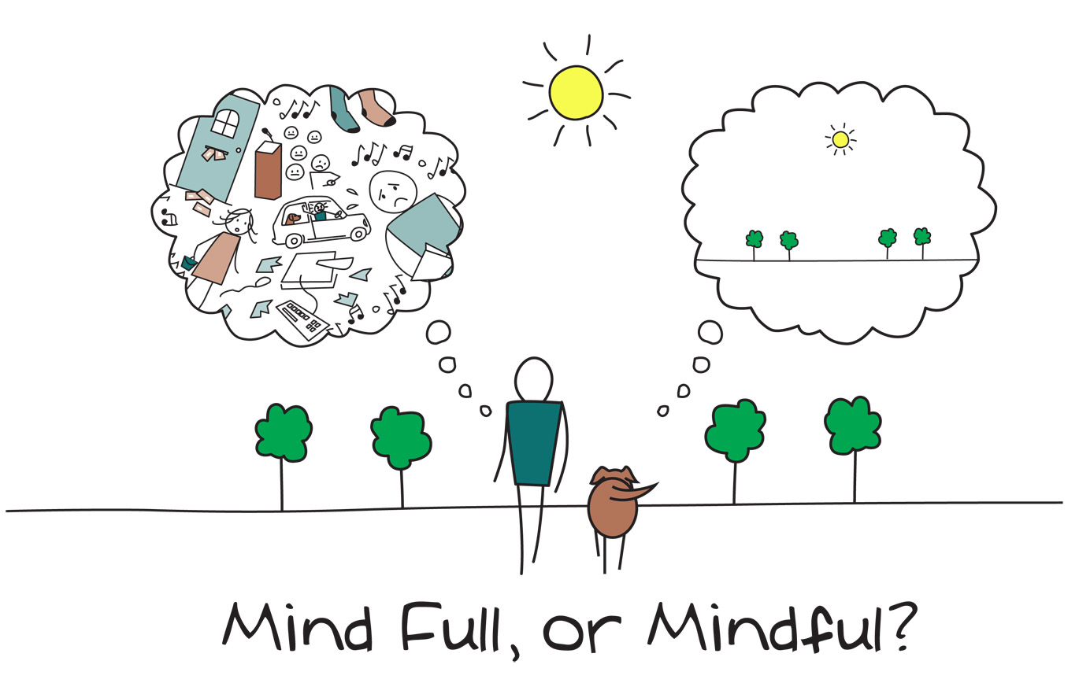
Mindfulness
Notes:
As we said in the last session, when you come into each session there may be lots of things on your mind. You might have thoughts about what you’ve been doing, what you need to do, maybe some expectations or perhaps worries about what the group itself will be like. Our minds often wander and life is sometimes filled with stresses or worries.
To start off today, and at the beginning of our future sessions, we will carry out a brief breathing exercise. The aim of this is just to help us be more present ‘in the moment’, and give us some time to become more aware of our thoughts, feelings and any physical sensations.
As we’ll see later in the course, this can also support our cognitive functioning and help our memory along with promoting overall well-being. If you have difficulty focusing on the breath (e.g. due to breathing difficulties) then go at a pace that feels comfortable to you, stop the meditation or focus on another part of your body, such as your feet.
Below are some of the core principles of mindfulness:
The ‘being’ mode: Mindfulness says that often we are so caught up in these thoughts about the past and future (the ‘doing’ mode) that we end up not paying attention to what’s happening around us now (the ‘being’ mode).
Self-compassion: We often have so much compassion and empathy for others that we forget to have the same for ourselves. Mindfulness is about extending some of this kindness to ourselves.
Mindfulness can have a positive impact on lots of areas of our lives including:
Emotional wellbeing: becoming more aware of our unhelpful thoughts and feelings and distancing ourselves from these. This can help us to realise that thoughts are just that thoughts! We will talk more about this in sessions 5 and 6.
Physical wellbeing: Becoming more aware of our bodies can be very useful for managing stress and reducing the release of cortisols. This is because we’re often not even aware of the impact of stress on our bodies. We will also discuss this in more detail in another session
Cognitive functioning: Mindfulness can be used to help improve our attention. By becoming aware of our thoughts, feelings and physical sensations we can bring our attention back to the present moment and reduce how much time we spend in automatic pilot. This can actually also help us to train our attention and help us to process and encode information effectively.

Slide 7
Last Session: Summary
Overview of mood and cognitive functioning
How mood can impact on memory e.g. attention, sleep
How memory can impact on mood (thought cycles)
Which parts of the memory process mood can affect (attention, encoding)
General wellbeing tips (diet, sleep, exercise, mindfulness)
Notes:
Home practice: how was it? Any particular difficulties? Anything from previous session? Any strategies noted down?

Slide 8
Reviewing Weekly Goals
Trying out a new memory strategy for the week:
Were you able to do it?
Was it difficult to do?
Was it helpful/unhelpful?
Notes:
Home practice: how was it? Any particular difficulties? Anything from previous session? Any strategies noted down?

Slide 9
Reviewing our work
Session 1 Initial overview of cognitive processes – attention, information processing, executive functioning, visuo-spatial skills and language.
Session 2 Focus on memory processes – attention, information processing, encoding, storage and retrieval.
Session 3 External memory strategies – adapting our environment to support memory. Discussing our memory difficulties with others.
Session 4 Internal memory strategies – drawing on our inner resources to support memory.
Session 5 Mood and cognitive functioning.
Session 6 General wellbeing and cognitive functioning

Slide 10
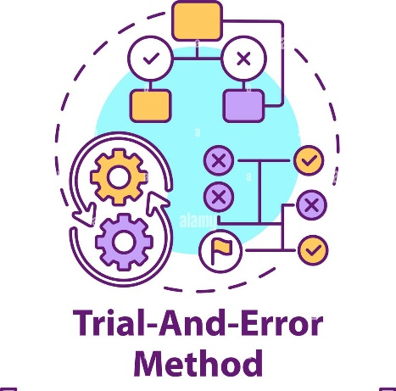
Reviewing our work
There’s been a lot of information to take in. As we have discussed, different bits of information and skills will feel most useful and relevant to different people.
When it comes to memory enhancement
strategies, a ‘trial and error’ approach can help
us try out different skills and work out what
works best for us.

Slide 12
Planning
It can be really helpful to plan how we might take forward and develop the skills and information discussed during the programme. Just like a toolbox, we can now put together our strategies or ‘tools’ to help support our memory.
Prepare | Decide what you are going to do, when, how and who with. Set time aside each day, perhaps in the evening, to plan the next day. Be realistic in what you hope to achieve – don’t put too much pressure on yourself.
List | Prioritise what would be the most important, most urgent, most helpful, most effective thing to do. Write it down (use a weekly planner, a diary or notepad). Try to make goals SMART (specific; measurable; attractive; realistic; time-bound)
Action | Do it! Put your plan into action.
Notice | Notice how the activity affects you. If it was unhelpful, then ask yourself if you could have done anything differently, or maybe decide not to do it again. If it has a helpful or positive effect, then plan to do more. What else could you do?

Slide 13

Memory Toolbox
Strengths
Difficulties
Strategies
What’s helpful?

Slide 14
Memory ‘Toolbox’
The parts of my memory that I have identified I have the most difficulty with are:
The parts of my memory that I have identified are my strengths are:
External memory strategies are those which involve making adaptions to our environment to support memory.
External memory strategies that I have identified I will put into practice in the future are: (A good tip is to look at your strengths and difficulties. For example, if your difficulty is retrieving information and visual memory is a strength, using a calendar or diary may help to recall information; drawing pictures or using photographs around the house may also help remind you to do things)
Internal memory strategies are those which involve our inner resources
Internal memory strategies that I have identified I will put into practice in the future are: (Review your strengths and difficulties. Using the example above, associating words or numbers with images or using the peg method may help to retrieve information from long term memory stores)
Three things I can do to look after my physical and emotional well-being to support my memory functioning are:

Slide 15
The Process of Memory
Attention
First you must focus on something; this includes listening and looking.
Information Processing
Then you have to process and understand that information.
Encoding
That information is then changed into a way that the brain can understand and store it.
Storage
Once encoded, the information is stored into your memory.
Retrieval
Once it has been stored, we must be able to pull the information back out; as and when we need it.
Notes:
The process of learning and remembering is quite complex and requires lots of different abilities and skills. This includes attention, information processing, encoding, storage and retrieval.
When we talk about memory or say my memory is bad, its easy to think of memory as one singular function. By being specific about what memory difficulties we notice and what aspects work better can help us to identify where in the process our main difficulties are. Therefore we’re able to come up with more effective and targeted strategies to support memory.

Slide 16
Questions and Discussion
?

Slide 17

Group measures
Notes:
Explain that participants will be asked to complete measures now and at the end of the course. This to monitor any general changes following the group, and to ensure that the group is meeting its’ aims.
Individual responses will not be identifiable. The front sheets will be used to match pre and post measures but will then be removed and shredded.

Slide 18

Saying our goodbyes
The aim of this group was to help you learn more about your memory, to identify strengths and any difficulties and to think together about some strategies to help manage difficulties.
Remember that it takes time to identify and implement new strategies and it can take time for these to work so be patient and allow yourself time to adjust.
It can also take time to practice and consolidate these skills. However, using them on a regular basis will give them the best chance of becoming effective.
Sometimes attending groups and saying goodbye can cause us to have difficult thoughts and feelings. If you’re experiencing any difficulties please feel able to arrange a time to discuss this with us.

Slide 19
Thank you for attending
Grace Sunerton, Assistant Psychologist
Jessica Haselhurst, Trainee Clinical Psychologist
01782 275188
Notes:
Contact details if you are having difficulties with the programme. There will also be space to ask any questions and explore with us your difficulties within the group if you feel comfortable sharing these.

